Slide 1
Energy Data Set
Presented By
Dhairya
Aditya
Ranga Chari
Guided By
Prof. Shrikant

Slide 2
Exploratory Data Analysis
We use Exploratory Data Analysis to identify the main feature of the data set using visualization methods
It helps to identify the relationships between variable which helps us decide what are dependent and independent variables of the data set

Slide 3
EDA for Energy DataSet
Looking at the data set we found that Appliances and Lights were the energy dependent variables and soon realized that Lights column in the data set had many blanks which had to be handled.
So to make the analysis for the complete house we have introduced the Energy_consumed column which is the combination of (Appliances+Lights) which becomes our dependent variable
All other parameters become independent variables which can be seen in the graphs.

Slide 4
EDA
1 - correlation between variables
2 - categorical variables or continuous variables?
3 - relation between number of samples and number of variables
4 - are the samples independent or is it a time series?
5 - creating new columns to improve and better the analysis and also to manage missing data

Slide 5
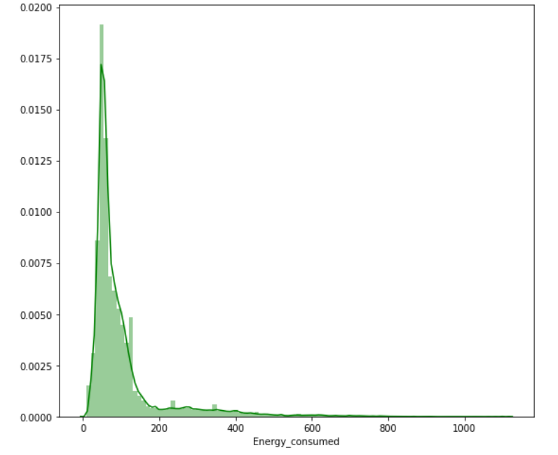
Distribution Curve of Appliances

Slide 6
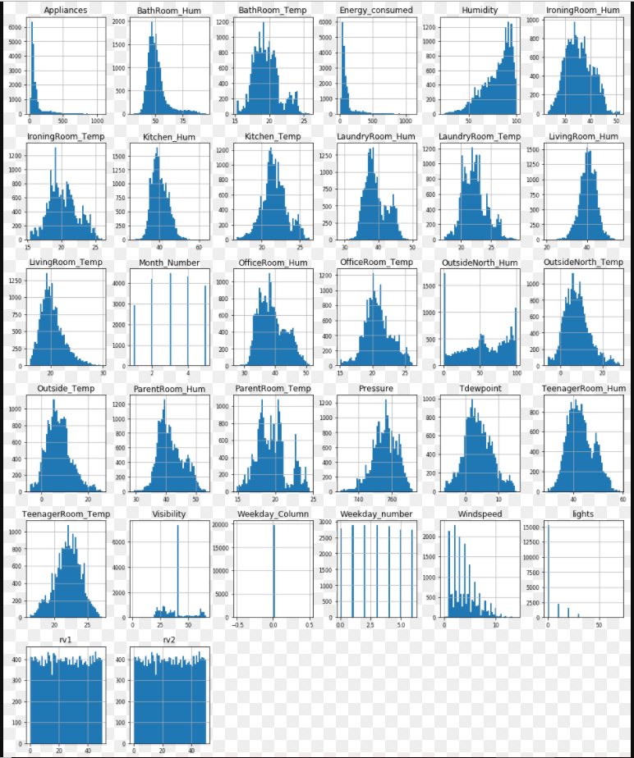
Histogram for Numerical Features

Slide 7
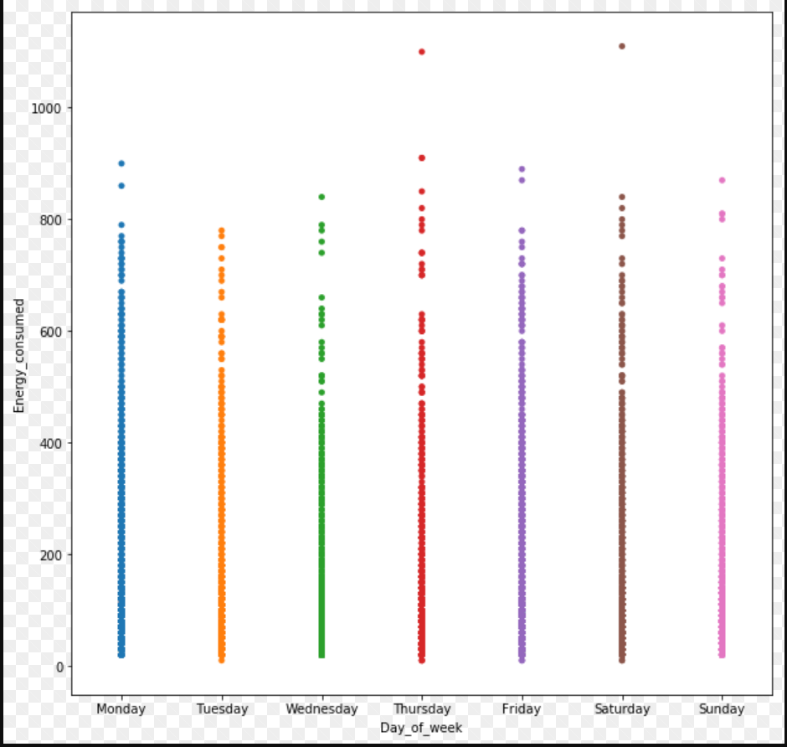
Strip plot to identify Max energy usage

Slide 8
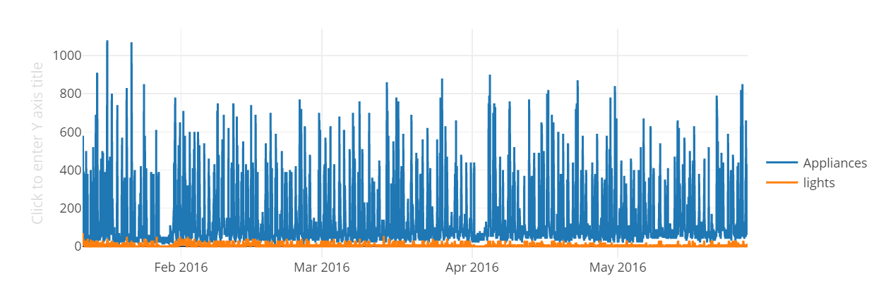
Time Series Plot
This plot is an analysis of Date vs Appliances as well as Date vs Lights usage

Slide 9
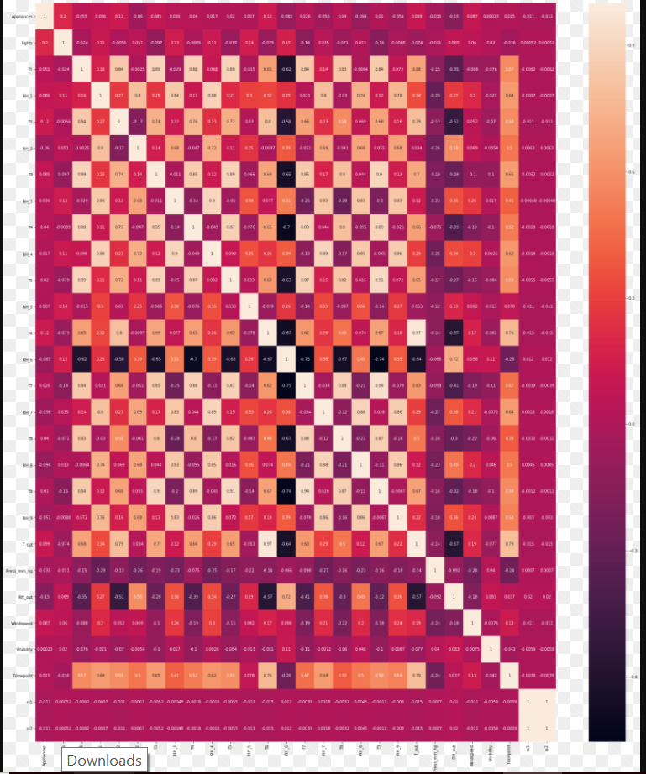
Identifying Correlations

